Slide 1
Is Prefetcher Research Still Alive?
Data Prefetching Championship #4
Leeor Peled, CPU uArch Research, Huawei
Jan 2026

Slide 2
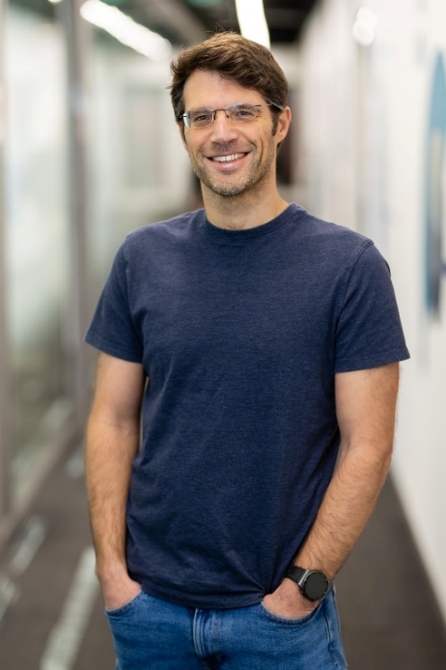




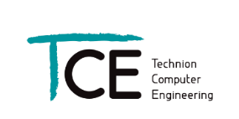
Short bio ☺
PhD at the Technion under Prof. Uri Weiser & Prof. Yoav Etsion) focused on ML based prefetchers with rich context (Q-learning, bandits, Neural networks, LSTM)
20+ years doing CPU core architecture
Intel Haifa: working on various core clusters (FE, OOO, HWPF, L2) for Sandybrige, Ivybridge, Skylake, Cannonlake, Icelake (Sunnycove), Alderlake (Goldencove), Meteorlake (Redwoodcove)…
Huawei Israel: working on cores for Mobile phones (Huawei Mate), server CPUs (Kunpeng) and other domains.
Currently: Huawei, leading CPU architecture research (Israel, Zurich, Cambridge, Edinburgh, and China)
Prefetchers, Predictors, Parallelism, Caches, SW/HW codesign, System/OS, Dynamic optimization, Compilers, Power efficiency, …
HUAWEI

Slide 3
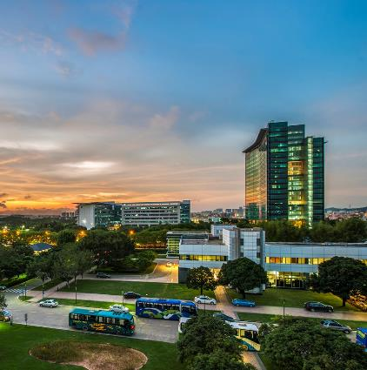




Huawei: A Global Provider of ICT Infrastructure and Smart Devices
Bring digital to every person, home and organization for a fully connected, intelligent world
Huawei's end-to-end portfolio of products, solutions and services are both competitive and secure. Through open collaboration with ecosystem partners, we create lasting value for our customers, working to empower people, enrich home life, and inspire innovation in organizations of all shapes and sizes.
At Huawei, innovation focuses on customer needs. We invest heavily in basic research, concentrating on technological breakthroughs that drive the world forward.
207,000
Employees
55.4%
R&D employees
170+
Countries and regions
Rank 4th
Global R&D investment

Slide 4
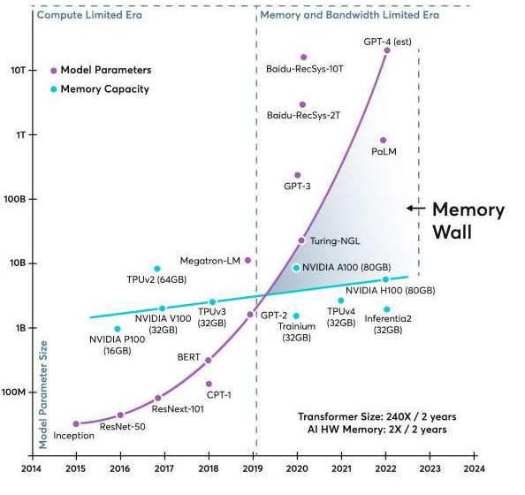
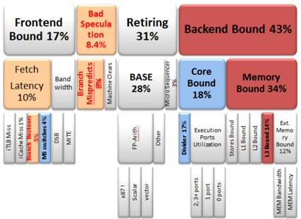
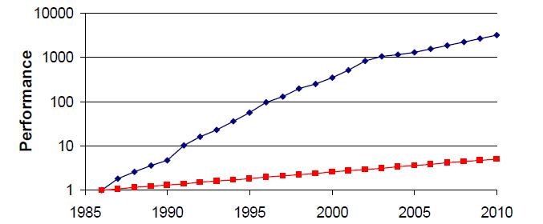
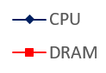
The memory wall (because we always start there)
Memory performance is not scaling as fast as needed!
Cache hierarchy offers some mitigation, but not enough
Will further degrade with core count, remote mem, networks, warehouse scale etc…
BW can be somewhat mitigated, but at a further cost for latency
So, we prefetch…
Gap
50% per year
Computer Architecture: A Quantitative Approach]
[Hennessy & Patterson
Ayar labs
Deep-dive Analysis of the Data Analytics Workload in CloudSuite
Yasin et al. [IISWC 2014]

Slide 5
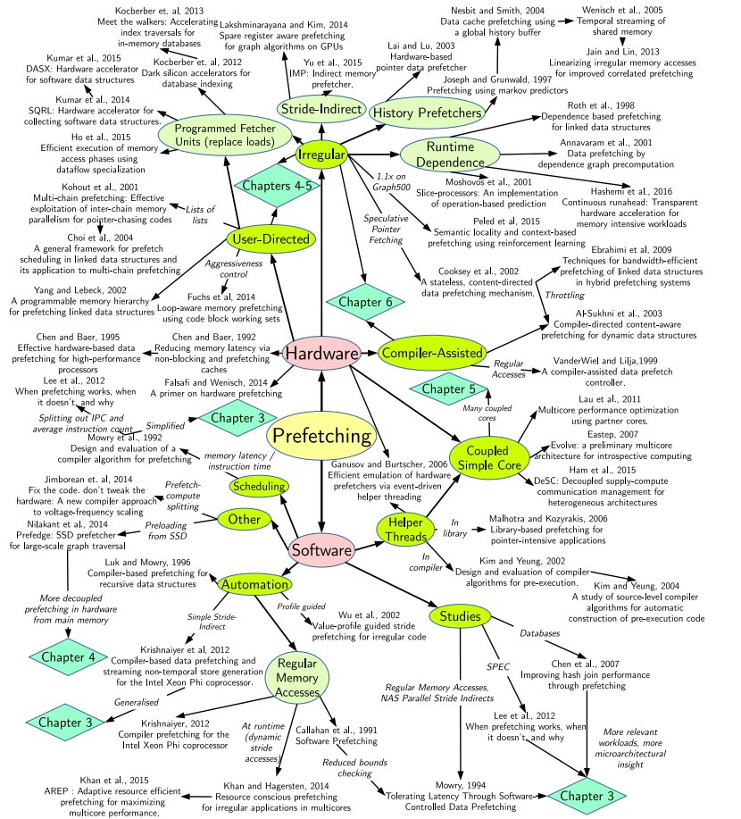
Related work per year
Technical Report: Prefetching for complex memory access patterns. Sam Ainsworth, 2018
#
year
Source: Google scholar stats

Slide 6

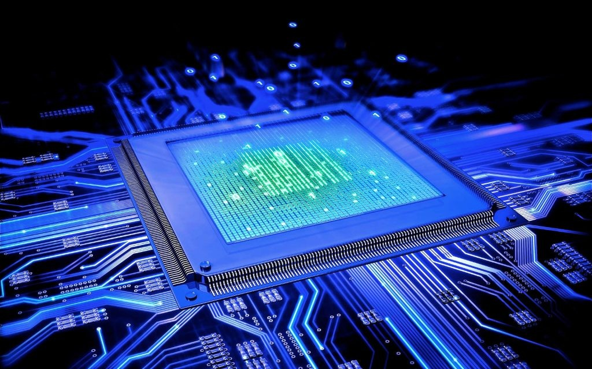
Designing prefetchers in 2026, still relevant?
BORN JUST IN TIME TO DESIGN THE BEST PREFETCHER EVER???
Is there still something to discover?
(Bonus question: Is it still possible to get a paper accepted?)

Slide 7
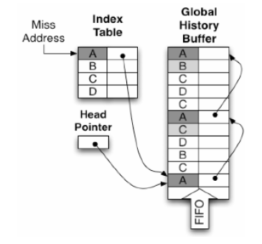
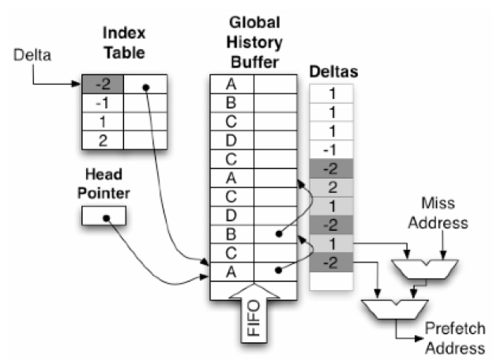
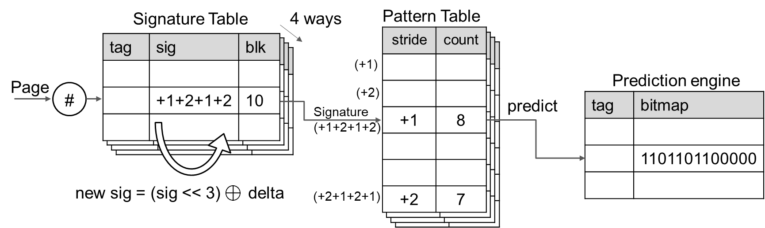
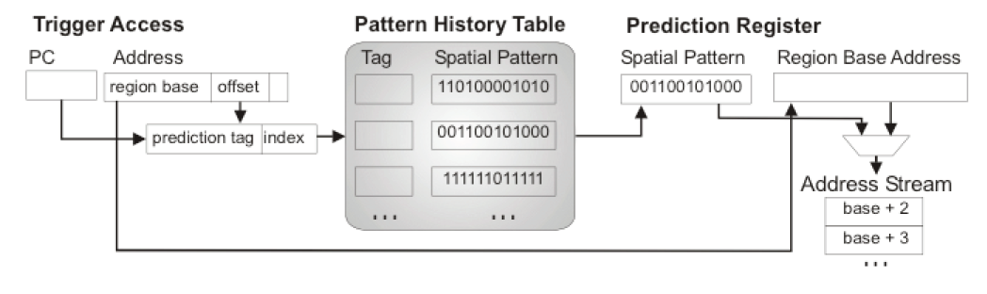
Brief history (non-exhaustive)
Spatial
Next line
Streaming prefetchers
Stride prefetchers
Alternating strides
Signature-based strides
Next stop: Irregular?…
Temporal
Early temporal (Markov)
History based (GHB-like)
Storage /optimization
Contextual correlations
GHB G/AC
GHB G/DC
Spatio-temporal
Recurring Deltas
Recurring patterns
Correlated patterns
SPP
SMS

Slide 8
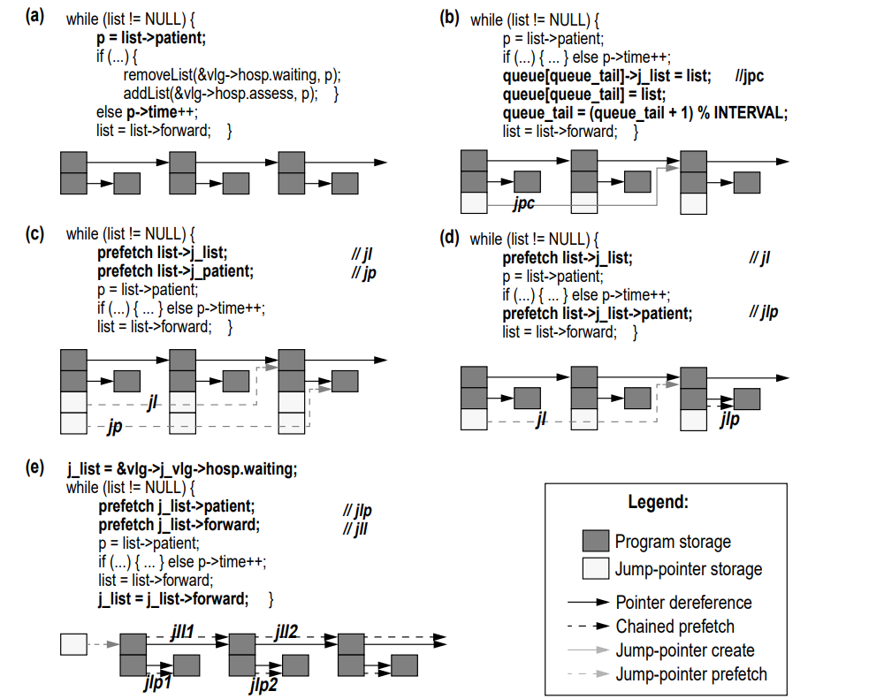
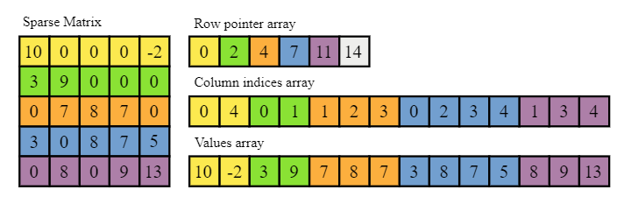
Irregular patterns
Horrible name, definition by negation!
What makes these patterns not regular?
Some examples
pointer chasing schemes
Linked lists
Skip lists / Jump pointers
Arrays of pointers
Arrays of indices
CSR/CSC
Graphs (optimized)
Linked data structures
Complex / H2P traversal algorithms
Random walks
Common idioms
[Roth & Sohi, Jump pointers, 99]

Slide 9
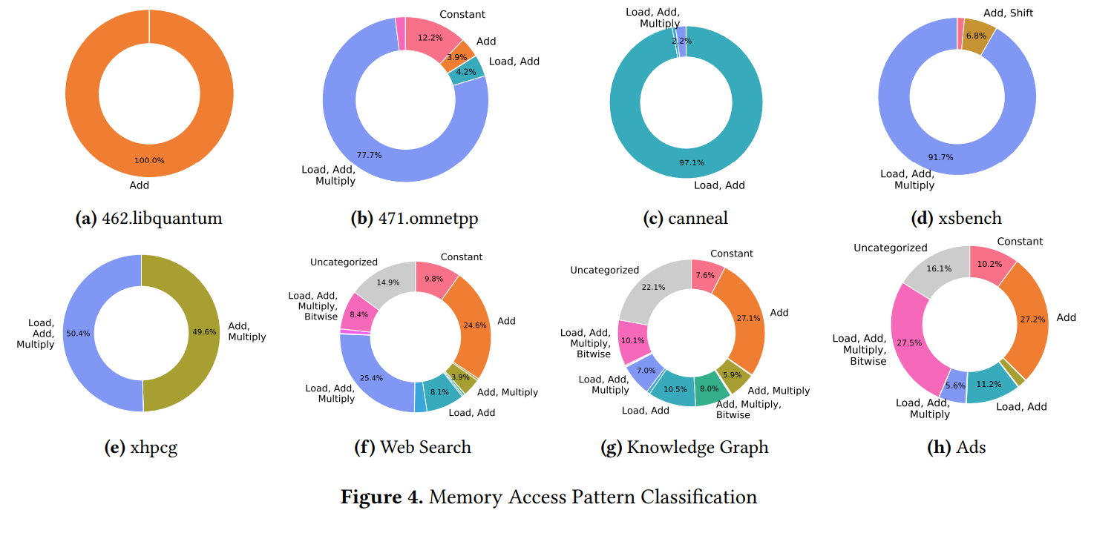
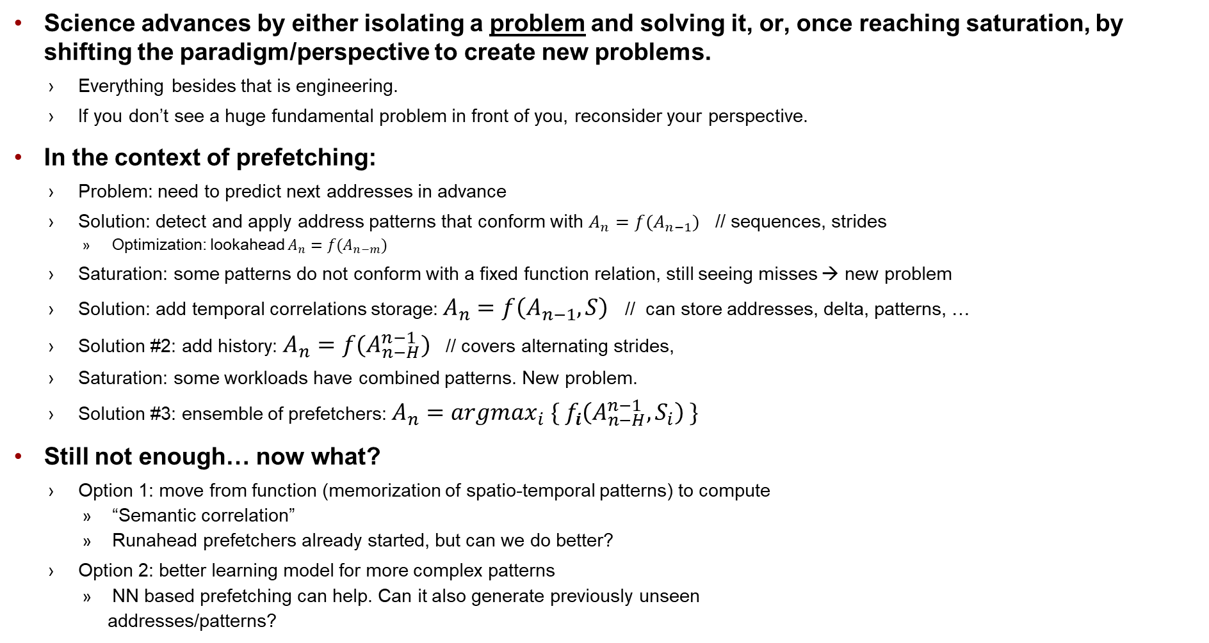
Why are we here?
Science advances by either isolating a problem and solving it, or, once reaching saturation, by shifting the paradigm/perspective to create new problems.
Everything besides that is engineering.
If you don’t see a huge fundamental problem in front of you, reconsider your perspective.
In the context of prefetching:
Problem: need to predict next addresses in advance
Solution: detect and apply address patterns that conform with $A_{n}=f(A_{n−1})$ // sequences, strides
Optimization: lookahead $A_{n}=f(A_{n−m})$
Saturation: some patterns do not conform with a fixed function relation, still seeing misses → new problem
Solution: add temporal correlations storage: $A_{n}=f\left(A_{n−1},S\right)$ // can store addresses, delta, patterns, …
Solution #2: add history: $A_{n}=f(A_{n−H}^{n−1})$ // covers alternating strides,
Saturation: some workloads have combined patterns. New problem.
Solution #3: ensemble of prefetchers: $A_{n}=argmax_{i} \{{ f}_{i}\left(A_{n−H}^{n−1},S_{i}\right) \}$
Still not enough… now what?
Option 1: move from function (memorization of spatio-temporal patterns) to compute
“Semantic correlation”
Runahead prefetchers already started, but can we do better?
Option 2: better learning model for more complex patterns
NN based prefetching can help. Can it also generate previously unseen
addresses/patterns?
Shift
Problem
Saturation
Solution

Slide 10
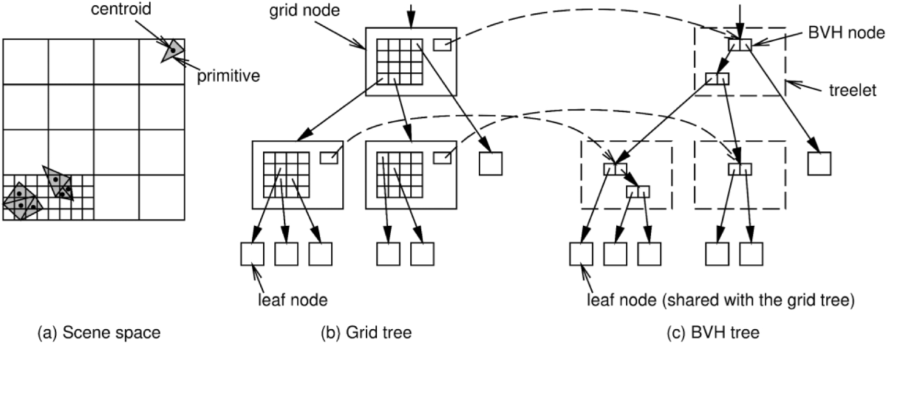
What’s left?
Complex patterns: what makes them so?
x = A(hash[i]) ;
x = x→ptr1→ptr2;
x = cond? y : z;
Find better temporal correlations
How can we record only the relevant relations?
How can we trigger only the correct correlations?
Untangling interleaved streams
Multilevel prefetching
Orchestrate timeliness (L123 done, what rack scale (net/ storage)?)
Multicore fairness
Avoid all-or-none throttling on symmetric cases
Divide the cache and BW resources based on who may benefit the most?
NP hard even if we knew the future benefit (which we don’t..)
Speculate benefits, approximate optimal distribution
Specialized workloads
AI tiling, token reuse, weight reuse
Raytracing, Databases, KV caches
ML based prefetching
RL based techniques already proposed for action learning
MAB / Context bandits / Pythia
Can we generate addresses directly using ML/DL?
Bit level / offsets / embedding / something else?
Do we (finally) join the LLM wagon?
LLMs train over large text sequences
Attention based models help us find optimal context
Can we use memory traces (possibly augmented with further context) are input streams?
Feed them onto an offline model, let it learn the probability
Let the attention scheme work its magic
…
Profit?
But..
What’s the use of an offline model?
Find a way to distill the model learning and extract insights on previously unseen pattern
… or just ask the model to build you a prefetcher and look for a new job.
How do we generalize?
A→
B D
C

Slide 11
Questions?

Slide 12
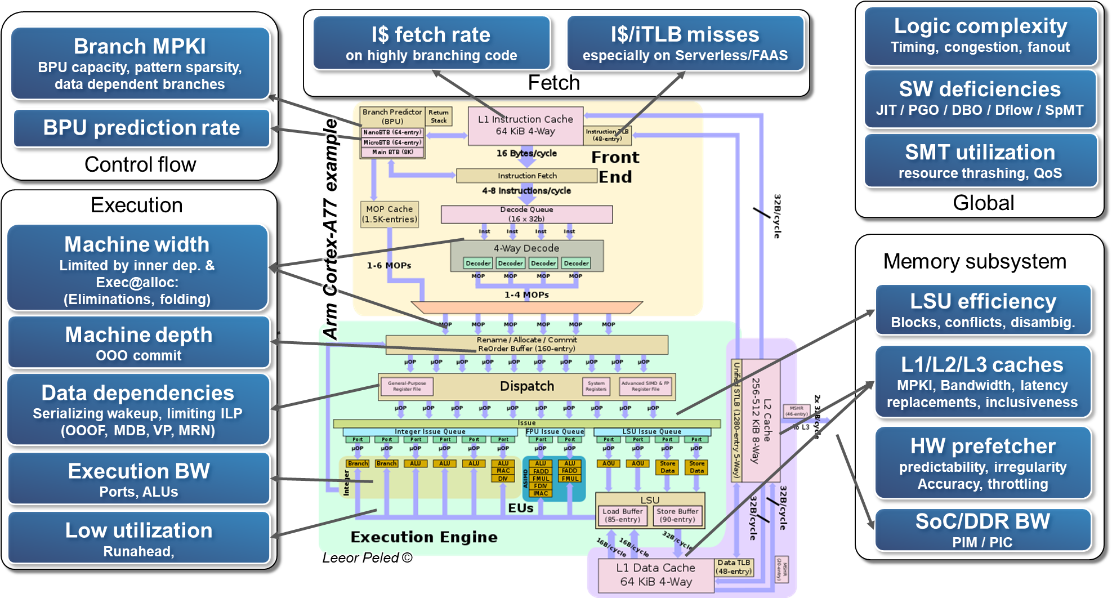
Performance bottlenecks in modern CPUs (and some mitigations)
What else?
Additional domains (SoC, MC, networking, storage,…)
System level behavior
Dedicated workloads
Deeper granularity
Something entirely new?

